Slide 1
The Importance of Corporate Social Responsibility
Patrick Madden, Terry Yang, Olivia Fernandez, Carlton Thomas, and Monica Hakun

Slide 2
WOW Factor
Video
Notes:
http://www.lenovo.com/social_responsibility/us/en/sustainability_policy/

Slide 3
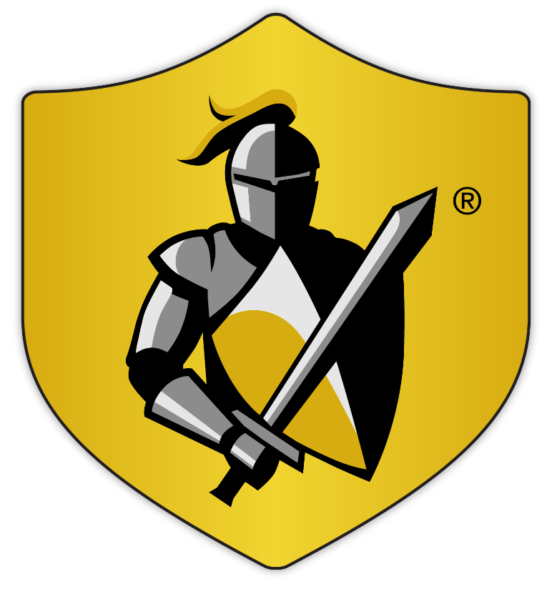
The Black Knight Mission
To be the PREMIER BRAND for technology in the mortgage industry known for PRODUCT EXCELLENCE and to deliver INNOVATIVE, SEAMLESSLY INTEGRATED PRODUCTS with SUPERIOR CAPABILITIES, FUNCTIONALITY and SUPPORT that enable our clients to:
Better manage and mitigate risk
Realize greater efficiencies and drive improved financial performance

Slide 4
What is Corporate Social Responsibility?
CSR is a business management practice that involves assessing and managing risks and opportunities that arise from environmental, social, and economic impacts of the company and its industry
It covers companies’ active participation in different fields:
It is increasingly viewed, across the world and across all business sectors, as a strategic issue to ensure the development of a sustainable world, and to enhance business competitiveness.
human rights
human resources
relations with clients
suppliers and other stakeholders
corporate governance
environment
contribution to community and society.
Notes:
CSR often represents the policies, practices and initiatives a company commits to in order to govern themselves with honesty and transparency and have a positive impact on social and environmental wellbeing

Slide 5
Why is Corporate Social Responsibility important?
Sustainability reporting is the future of business
All publicly traded companies within the EU will be required to report on sustainability in 2017
A PwC survey found that 1/3 investors considered sustainability in their investment strategy
The State of California requires all retail sellers and manufacturers having worldwide annual revenues of $100 million or more to disclose sustainability reporting
Improves access to capital
Improves ability to retain and attract employees
Enhances reputation
Synthesizes what we currently do at Black Knight into a discrete focused deliverable, delivering incremental value to the organization
Wins shareholder and stakeholder trust
CSR reporters score 15 points higher on trust with investors

Slide 6
CSR and its impact on QVR
Q
V
R
Greater Control
Lower Costs
Mitigate Risk

Slide 7

Sustainability Programs in our Domain Our customers expect it. Premier brands do it. Our competitors do not.
Top 5 Accounts
Key Accounts / LoanSphere Clients
Peers
Company | Formal GRI Reporting | †Return on Assets (%)
BAC |  | 0.23
Chase |  | 0.87
Citigroup |  | 2.38
US Bank |  | 1.53
Wells Fargo |  | 1.44
Company | Formal GRI Reporting | †Return on Assets (%)
CapitalOne | X | 1.46
Citizens | X | 0.68
*loanDepot | X | N/A
M&T | X | 1.17
PNC |  | 1.26
Regions |  | 0.97
Santander |  | 0.46
*Stearns | X | N/A
SunTrust | X | 0.97
Union Bank |  | 1.27
Company | Formal GRI Reporting | †Return on Assets (%)
CoreLogic | X | 2.25
Broadridge | X | 12.59
Ellie Mae | X | 5.70
Equifax | X | 7.97
Experian |  | 9.00
FIS | X | 4.77
Fiserv | X | 8.00
‡Wipro |  | 15.52
Apple |  | 18.01
IBM |  | 9.86
Microsoft |  | 14.02
Of Black Knight’s peers, those that publish formal sustainability reports outperform those that do not by an average of 48% when measuring Return on Assets.
*Private Company
†Source: GuruFocus (Year Ending 2014)
Key: = LoanSphere Enterprise Client
‡Mandatory in India

Slide 8
Company | GRI Reporting | CSR Program | ROA
Key Bank | ✓ | ✓ | 0.91%
Capital One | ✓ | ✓ | 1.22%
Fifth Third Bank | ✓ | ✓ | 1.18%
PNC | ✓ | ✓ | 1.15%
Regions | ✓ | ✓ | 0.90%
Union Bank | ✓ | ✓ | 0.90%
BBVA Compass Bank | ✓ | ✓ | N/A
Commerce Bank | ✓ | ✓ | 1.11%
Genworth | ✓ | ✓ | 0.16%
Northern Trust Co. | ✓ | ✓ | 0.88%
SunTrust | X | X | 1.02%
M&T | X | ✓ | 1.02%
Santander | X | X | 0.53%
Citizens |  |  | 0.62%
Company | GRI Reporting | CSR Program | ROA
Bank of America | ✓ | ✓ | 0.71%
Chase | ✓ | ✓ | 0.96%
Citi | ✓ | ✓ | 0.88%
US Bank | ✓ | ✓ | 1.40%
Wells Fargo | ✓ | ✓ | 1.28%
Company | GRI Reporting | CSR | ROA
Accenture | ✓ | ✓ | 16.13%
Altisource | X | X | 13.31%
Broadridge | X | ✓ | 12.94%
CGI | ✓ | ✓ | 8.53%
CoreLogic | X | ✓ | 3.88%
D+H | X | X | 2.82%
Ellie Mae | X | X | 5.80%
Ellie Mae | X | X | 5.80%
Equifax | X | ✓ | 7.90%
Exprian | X | ✓ | 8.67%
First American | X | ✓ | 3.76%
FIS | X | X | 3.78%
Fiserv | X | X | 8.91%
Wipro | ✓ | ✓ | 8.79%

Slide 9
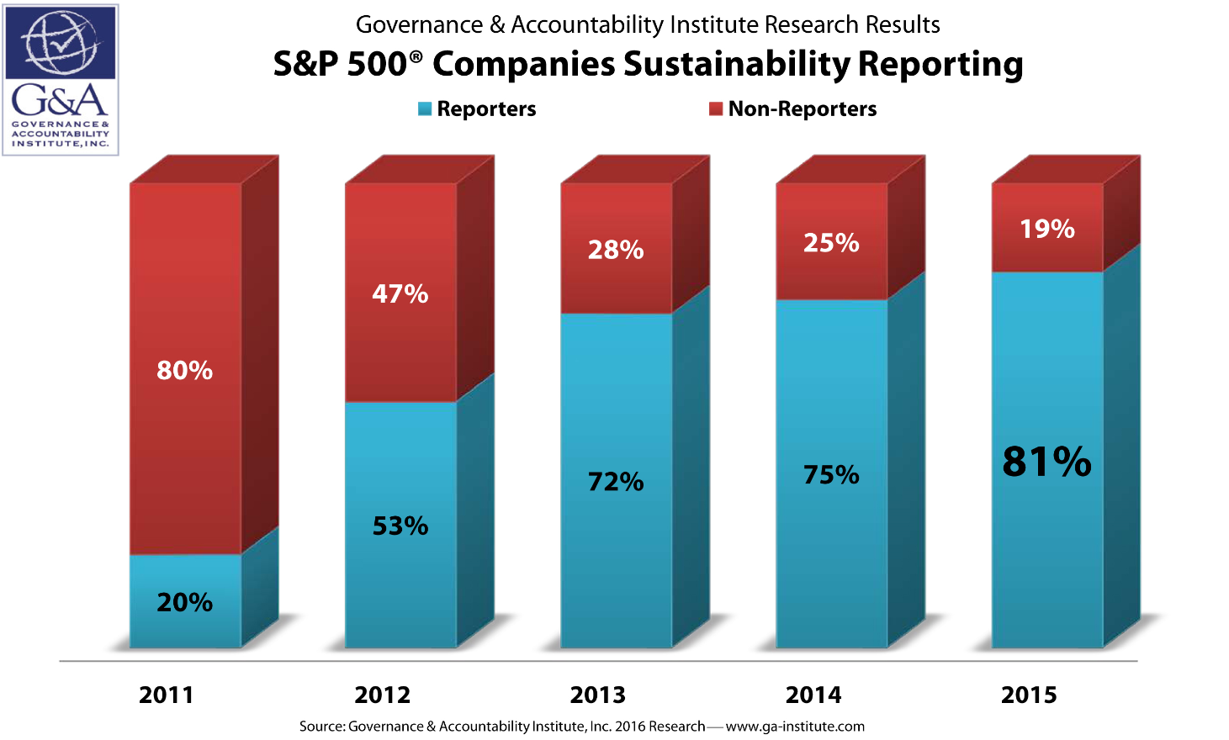
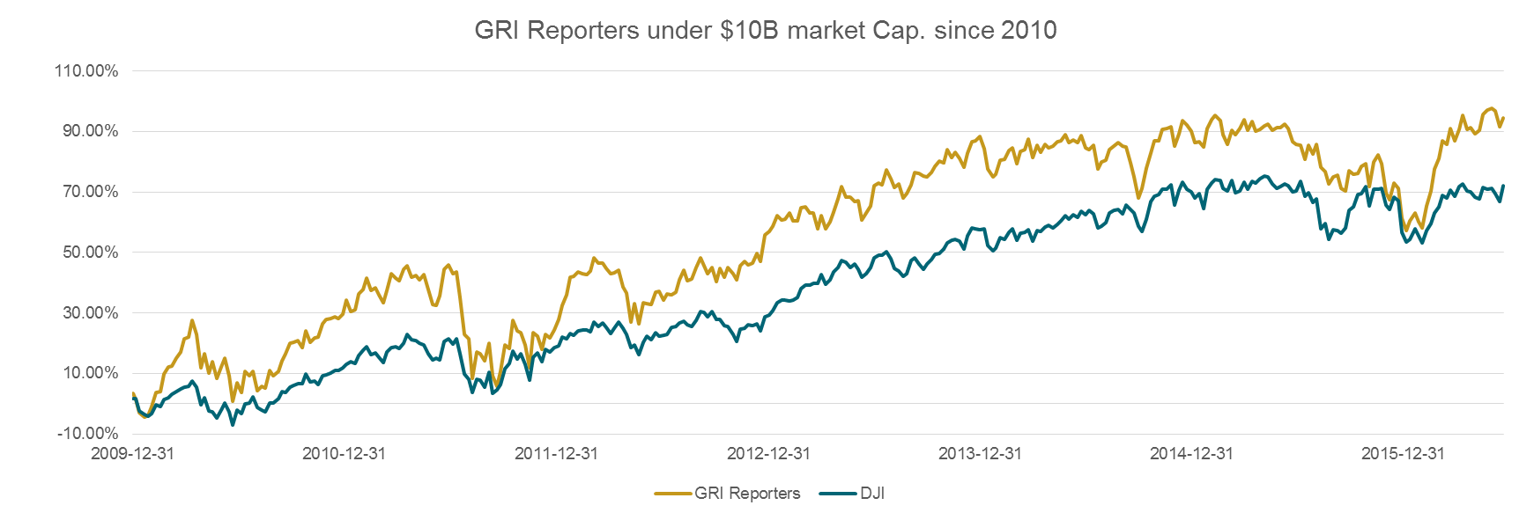
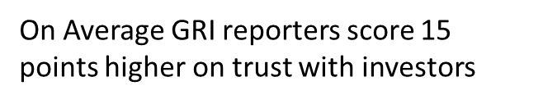
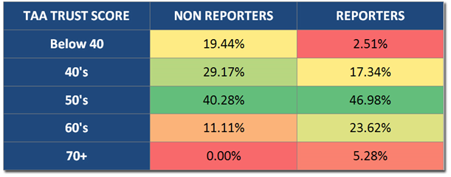
Trends - Premier Brands produce GRI in-depth sustainability reports
On Average, this group of GRI reporters outperformed the Dow Jones Industrial by 17.55%

Slide 10
Financial
WACC
Cost of Debt: -$9.2 million
Cost of Equity: unknown
Operating Expenses
Employees
Training cost
Hiring/retention
Energy
Taxes

Slide 11
Risk
Social Risk
Technological Risk
Economic Risk
Political Risk

Slide 12
How do we measure results?

Slide 13
“We already do this”

